Slide 1
Topic: Unrest and Discontent in the late 1800s
Do Now:
“Though the people support the government; the government should not support the people”
- President Grover Cleveland

Slide 2
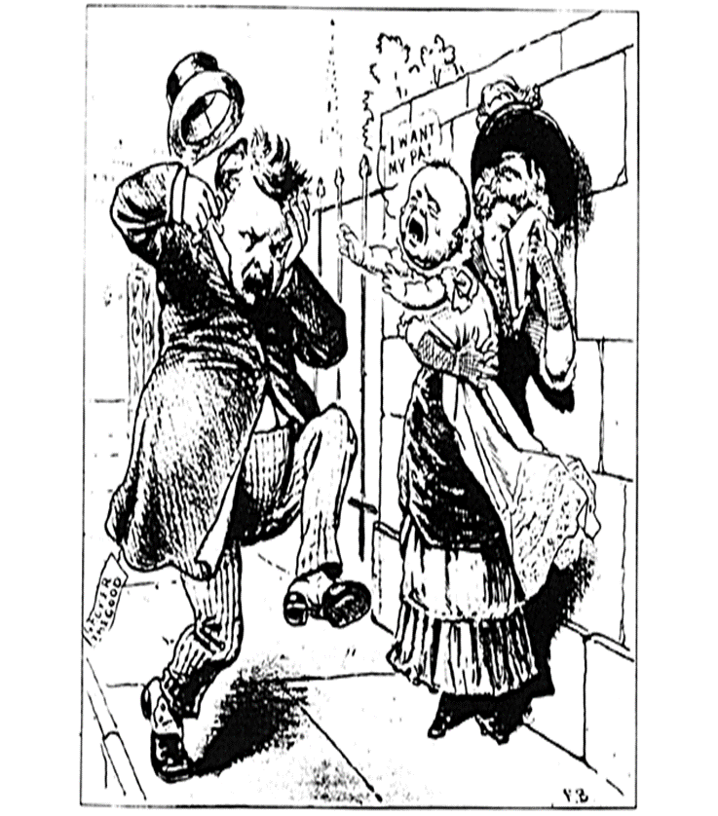
The 1880s
Election of 1884
Cleveland (D) vs. Blaine (R)
Mulligan Letter and the Mugwumps
“Rum, Romanism and Rebellion”
Cleveland’s Presidency (1st Term)
1st Dem since before Civil War
“laissez faire” economics
Haymarket Riot (1886)
Tariff Controversy
Election of 1888:
Ben Harrison vs Cleveland
Republicans team up w/ Big Business
Benjamin Harrison (R) wins

Slide 3
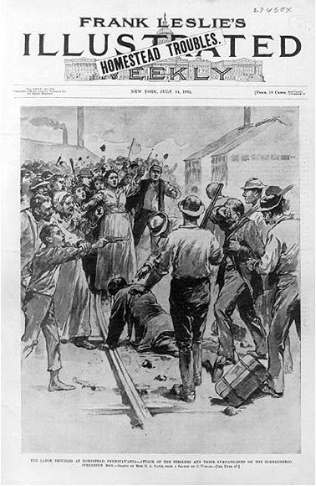
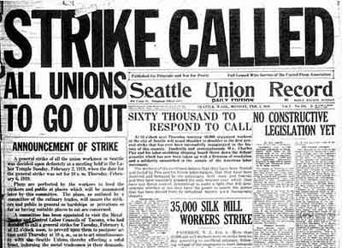
Economic and Social Unrest
Benjamin Harrison
“Billion Dollar Congress”
McKinley Tariff (helps US industry, hurts farmers, debtors)
Grange/Farmers Alliance → Populist Party (James Weaver)
Unlimited coinage of silver (16:1)
Railroad Regulation
Labor Unions involved in violent strikes
Homestead Strike (use of troops)
Election 1892
1892: Cleveland runs and wins
Depression of 1893 & Pullman Strike (1894)
Repeal of Sherman Silver Purchase Act
Poor angered

Slide 4
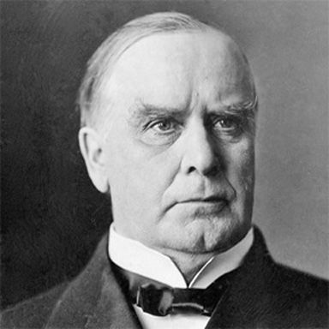
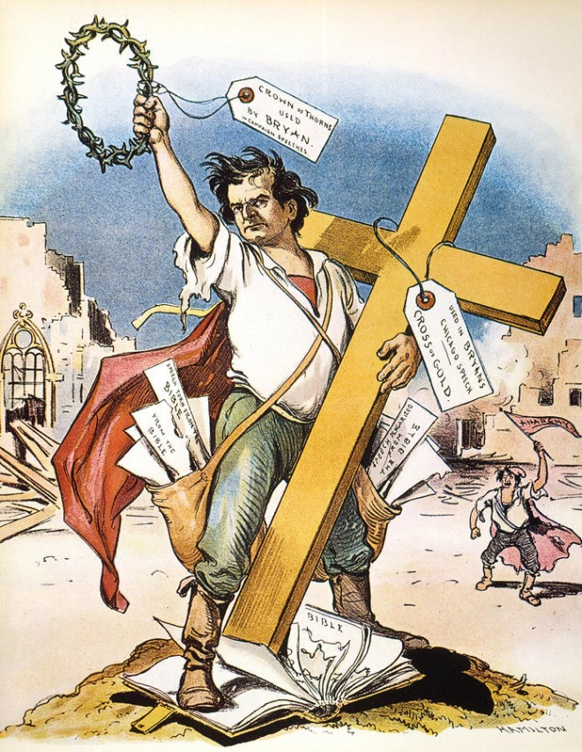
The Election of 1896- The End to Gilded Age
The Punishing Depression of 1893 and its Impact
William McKinley (Republican)
Allied with Party Bosses (Mark Hannah)
“Stand Pat”
Support of Big Business, Urban Workers (?!)
William Jennings Bryan (Democrat)
Tries to unify Populists and Democrats
Adopts many Populists beliefs (Silver Standard, Regulation)
“Cross of Gold Speech”
Support of Farmers
The Outcome

