Slide 1
Topic: America In the 21st Century: Growth or Decline?
“I believe the most solemn duty of the American president is to protect the American people. If America shows uncertainty and weakness in this decade, the world will drift toward tragedy. This will not happen on my watch.
America is a Nation with a mission - and that mission comes from our most basic beliefs. We have no desire to dominate, no ambitions of empire. Our aim is a democratic peace - a peace founded upon the dignity and rights of every man and woman”.
President George W. Bush
“I know my country has not perfected itself. At times, we've struggled to keep the promise of liberty and equality for all of our people. We've made our share of mistakes, and there are times when our actions around the world have not lived up to our best intentions.
On every front there are clear answers out there that can make this country stronger, and we're going to break through the fear and the frustration people are feeling. Our job is to make sure that even as we make progress, that we are also giving people a sense of hope and vision for the future”.
-President Barack Obama

Slide 2
George W. Bush and the War on Terror
1st Term
2000 election problem (Bush v. Gore)
NCLB
9/11 Terrorist Attacks
Bin Laden and Al Qaeda
“War on Terror”
PATRIOT Act, Homeland Security
War on Afghanistan
War in Iraq
Hussein and WMDs
“Bush Doctrine”
2nd Term
2004 election Bush vs Kerry
The Roberts Court
Hurricane Katrina
Wiretapping Scandal
Stalled Social Security Reforms
2006 Congressional Elections
Dem wins and failures
Iraq “Troop Surge”
Economic Problems

Slide 3
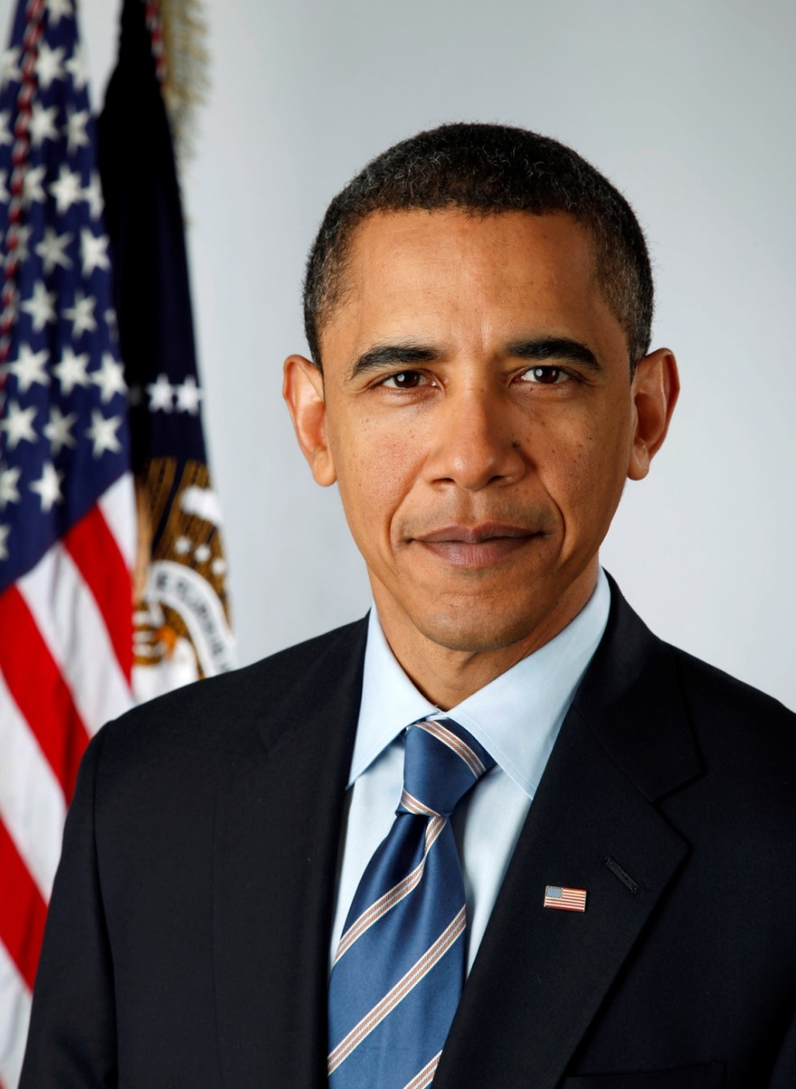
Obama: Change in America?
Election 2008
Obama vs McCain
Domestic Issues
TARP continued & “Bailout” of GM
The Stimulus Act
Passage of the Affordable Healthcare Act (“Obamacare”)
National Federation of Independent Business v. Sibelius
Eroding “Don’t Ask…”
Obergefell v. Hodges
Outsourcing and other economic woes
Budget Politics
Mandate/Entitlement Spending & Rise of the Tea Party
2010 midterm elections
Re-Election 2012
Obama vs Romney

Slide 4
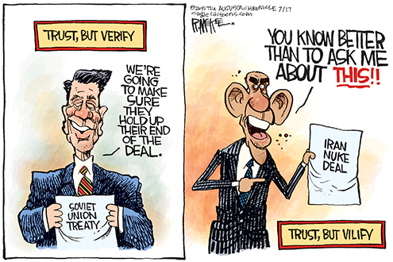
Obama’s Foreign Policy- “The Reset”
“Arab Spring” (Egypt, etc.)
The Cairo Speech and after
Russian “Reset”
NATO in Libya
Killing Osama Bin Laden (May 2011)
Iraq “Drawdown” (Dec 2011)
The Rise of ISIS
NSA Domestic “intelligence gathering” (Edward Snowden, WikiLeaks)
“Opening Cuba”
Iran Nuclear Deal

Slide 5
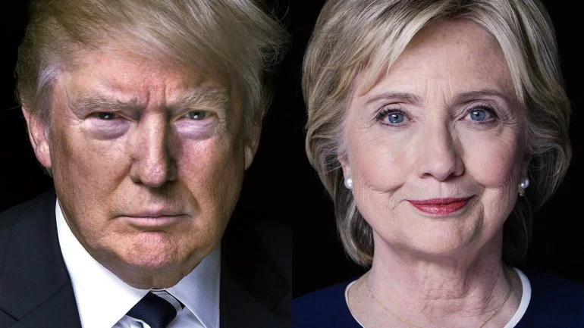
Election 2016 (Trump vs. Clinton)
Voter Discontent- reasons?
Anemic Economic Growth
Loss of industrial jobs (“rustbelt”)
Obamacare costs
Foreign Anxieties
Republican Divisions→ Trump
Democrats polarized (Bernie Sanders)
Reasons for Clinton’s Defeat
FBI Investigation of Clinton emails?
Russia and “Fake News”?
Misogyny?
Clinton’s lack of campaigning & message?
Disconnect between Democratic base and democratic leadership?

Slide 6
The Electoral Vote 2016

Slide 7
Popular Vote

Slide 8
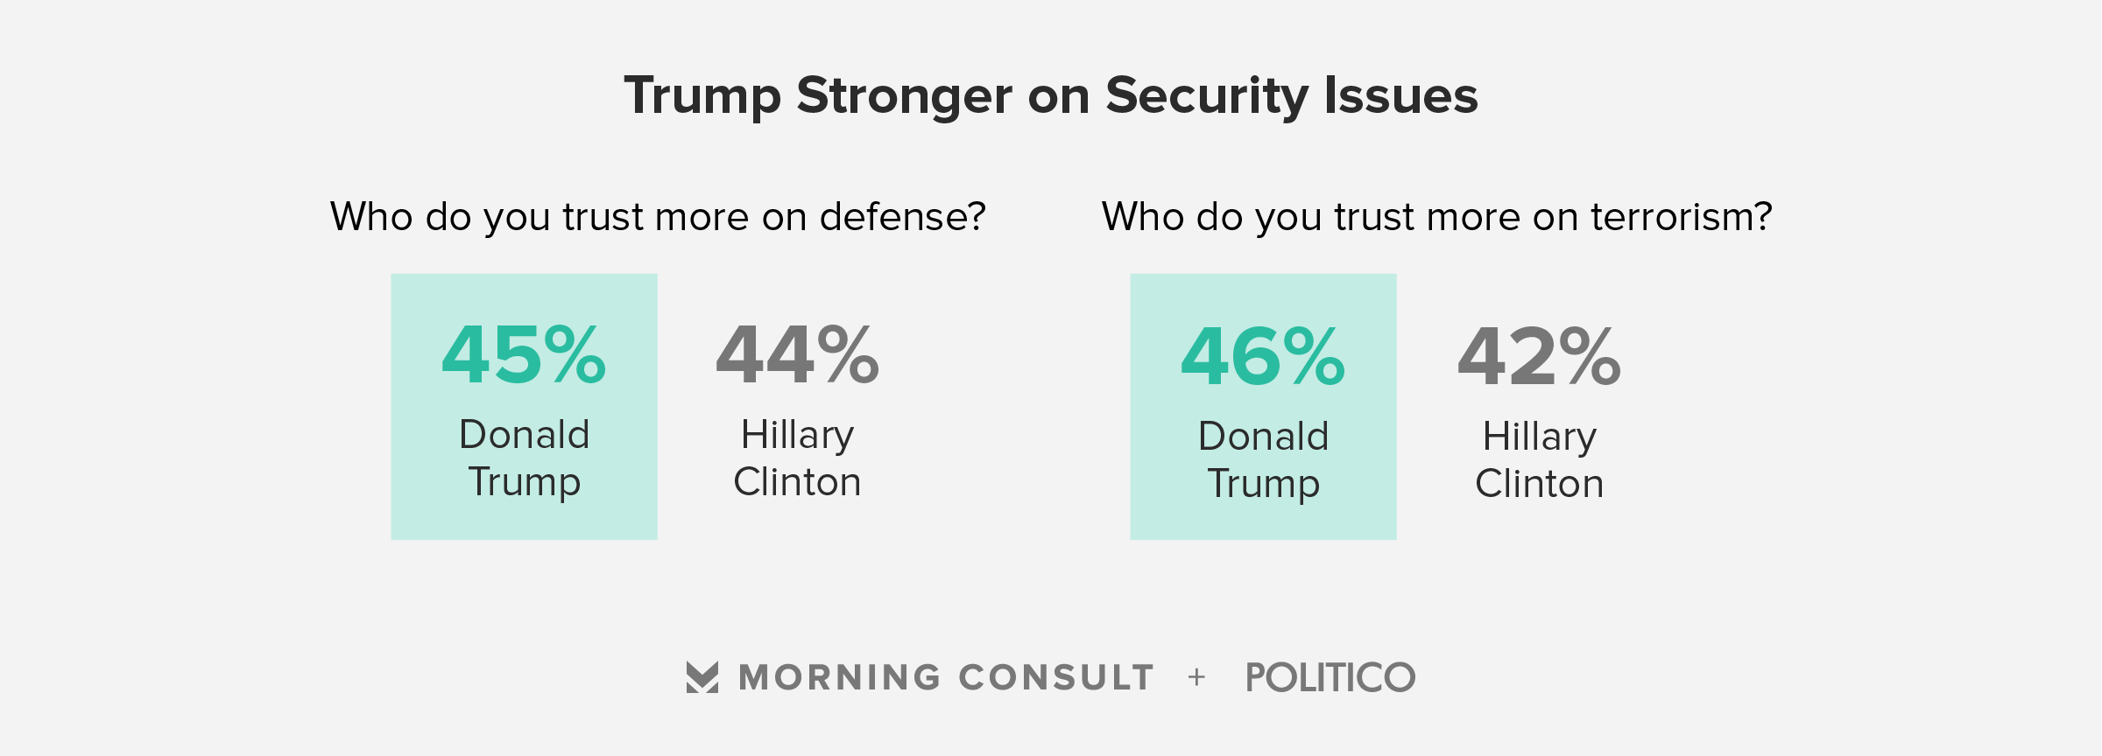
Voter Discontent: Tale of the Tape

Slide 9
A Little Historical Perspective (leaves out election of 1824)

Slide 10
Conclusion
Is America a nation that is growing, or is it a nation in decline? Using all of your AP US knowledge, explain your answer.

